Slide 1
Blind man reading machine

Slide 2
Under the mentorship of
Dr. Vinay Chamola
Assistant Professor
EEE Department

Slide 3
APOGEE PROTOTYPE PRESENTATION CATEGORY
APPLIANCE DESIGN

Slide 4
TEAM MEMBERS
Aman Shukla 2017A8PS0436P
Nitin Vinayak Agrawal 2017A4PS0415P
Sarthak Baral 2017A3PS0320P
Shantanu Nigam 2017A8PS0399P
Aryamick Singh 2017A8PS0389P

Slide 5
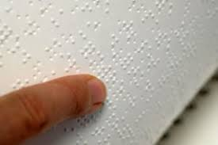
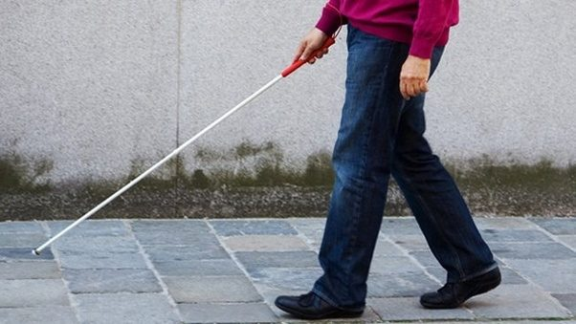
15 million blind people in India
37 million blind people across globe

Slide 6
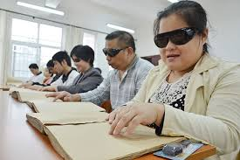
No commercially available product to help them read
News papers
can not be
printed in braille,
nor can every
book in market.

Slide 7

So what is the solution ?

Slide 8
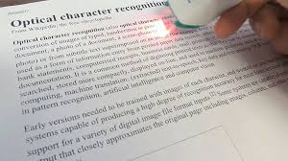
A simple dedicated device which uses OCR to read text and give audio output to the person.

Slide 9

With the help of this device, the person can read any text, with just a click of a button

Slide 10
The Working
Image is clicked by the webcam
Image is processed on raspberry pi
It includes grey scale setup, autocontrast and image thresholding.
The processed image is read with help of softwares
The created text file is read out by other softwares.

Slide 11
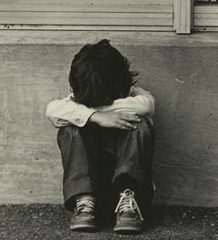
With the current development in the field of electronics, total negligence of a certain section of people is not justified when it is possible to cure their problem easily.

Slide 12
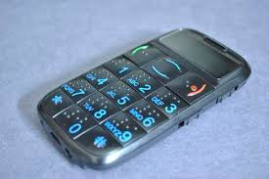
Need of the Device
There may exist other solutions for the problem like mobile app or special mobiles meant for the blinds.
But the problem arises…..

Slide 13
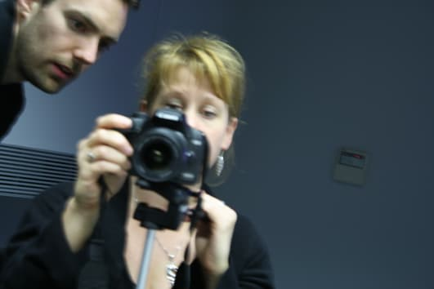
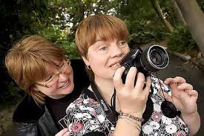
How can a blind man precisely click a photo?

Slide 14
With our dedicated device, the blind person can align the page and just press the button, rest all is done.
No need to focus on something you can’t see.

Slide 15

The prototype when goes into mass production will cost nearly 3000 ₹
At this cheap price, the person gets to read all the books, newspapers, letters and what not.
It is of course not like getting eyes back, but it is a great help to them anyhow.

Slide 16
Project Approval
To fulfil our endeavours of helping others and making life easy for not so gifted people of the society, we have also been awarded L K Maheswari grant from the EEE/ENI department which we have judiciously used for our cause.

Slide 17
Thank you

